Slide 1
This presentation was designed for grade school ages (5-10 years old)
These kids will have short attention spans so keep that in mind with how in-depth you go
Wear your uniform and bring your hat to look the part!
This is a sample outline. Feel free to use these slides as a foundation to customize your own presentation to best suit your event and audience.
Change the Titles, customize the text to your own experience, add photos of YOU!
To add a slide, “right click” on a slide to the left and click “Duplicate Slide to keep the Header Formatting.
Email the presentation to yourself AND bring it on a portable flash drive to take to the classroom or event. (Just to have a backup!)
If you add video, test it once you get there before getting started. Have the web address handy (opened in another window) or file loaded onto your flash drive as a backup so the transition goes smoothly.
The audience is more interested in your story. What made you want to become a pilot? Reference the activities and materials document for more ways to enhance your presentation.
Reference the activities and materials document for more ways to enhance your presentation.
Find out beforehand how much time you have. Time yourself and trim/add more content as needed. Be sure to leave time at the end for questions! There will be some funny ones!
Don’t forget to delete THIS SLIDE before giving your presentation. : )
Enjoy the event and thank you for volunteering to shape the next generation of aviators!

Slide 2
Career Day
Grade School
Teacher’s Classroom
Date
Name
Pilot for xx Airline

Slide 3
Video
Select a Short Video to get the kids’ attention and make it fun for them!
https://www.youtube.com/watch?v=q-0yTGVRPvk
https://www.youtube.com/watch?v=aY3CzAIDrqw
https://www.youtube.com/watch?v=QggNdV9TmvA

Slide 4
Audience Survey
Who has flown on an airplane?
Where did you go?
Favorite part?
Who wants to be a pilot when they grow up?

Slide 5
Trivia
What year was the first flight?
Who were the pilots?

Slide 6
My Inspiration
How old you were
Specific event when you first wanted to be a pilot
Role models?

Slide 7
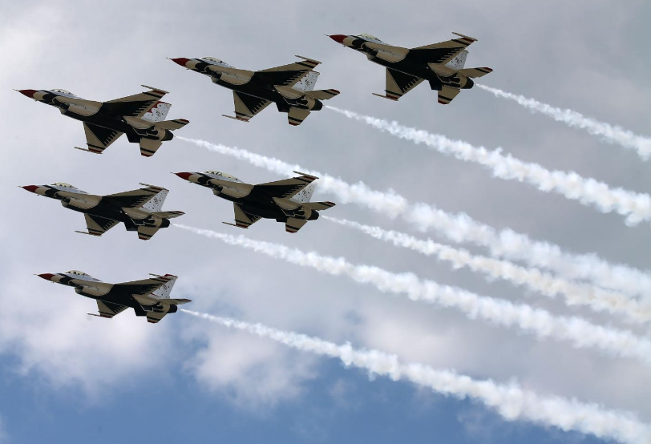
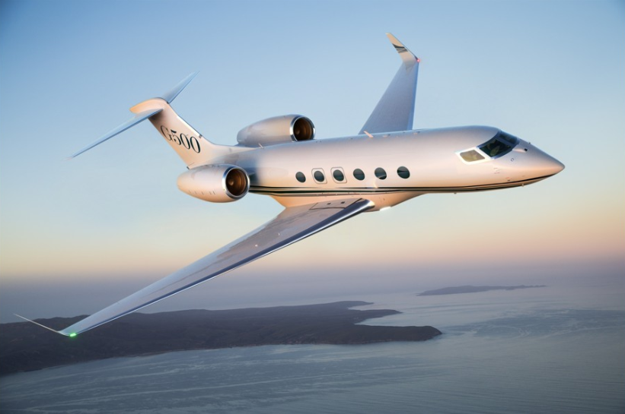
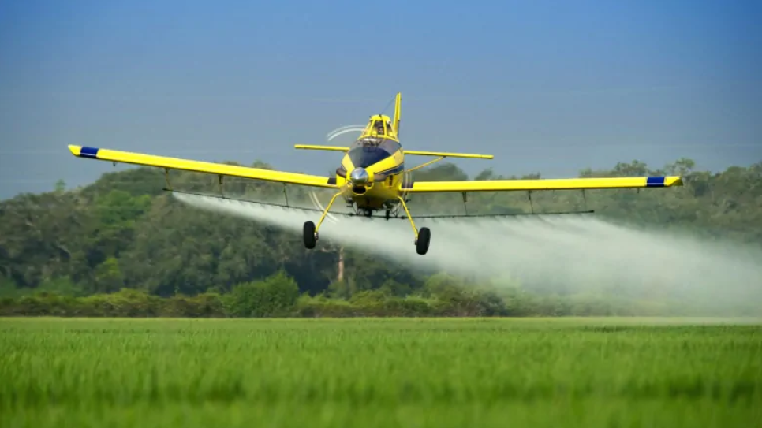
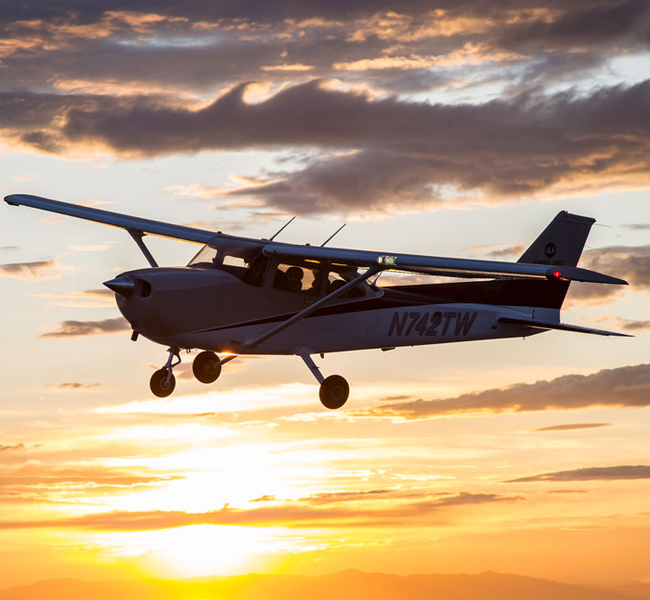
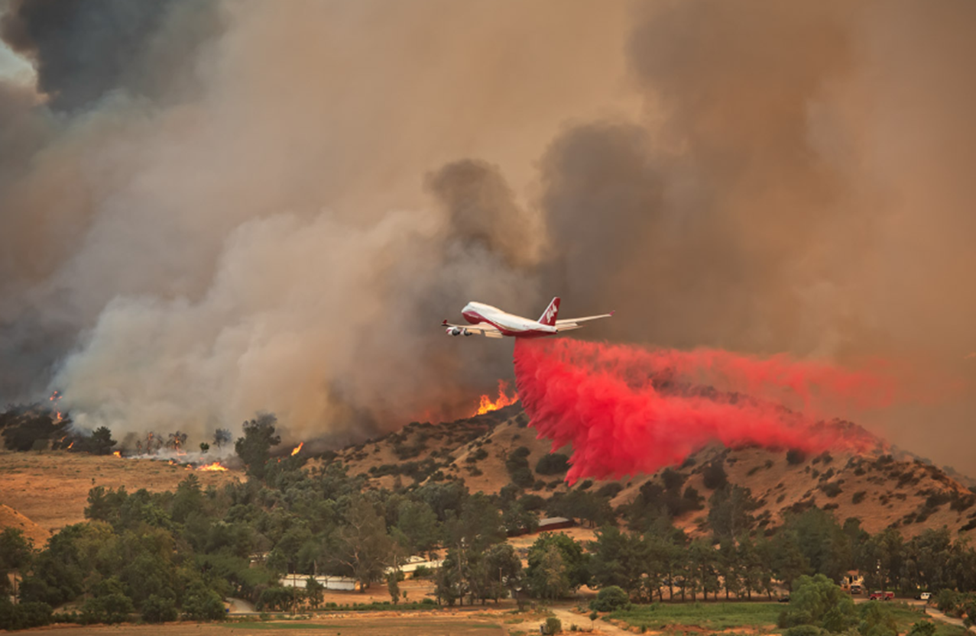
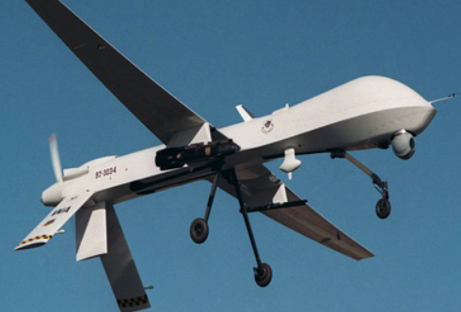
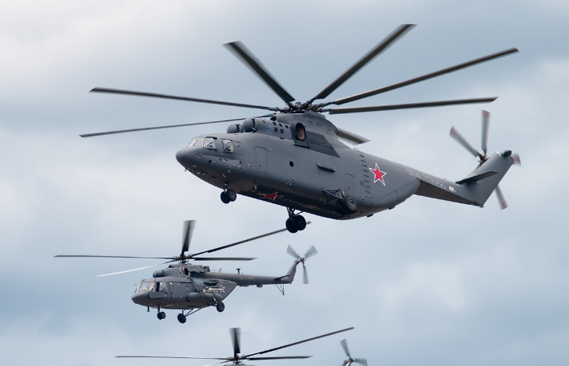
Types of Pilots

Slide 8
My Path to Becoming a Pilot
Flight Training
School
Airplanes
First Job
Company
Airplane flown
Next Job
Company
Airplane flown

Slide 9
About Me
Current Job
Job Title
How long you have been here
What you currently fly
Where you fly
Anything particularly interesting about this job

Slide 10
The Airplane I Fly
Minimum Crew: 2 pilots
Weight: 585,000 lbs.
Cargo: 170,000 lbs.
Minimum Landing: 3,000 ft.
Passengers: 102
Range: 6200 miles (12 hrs.)
Speed: 500+ mph
Max Altitude: 45,000 ft.
Wingspan: 170 ft.
Length: 174 ft.
Height: 55 ft.
Width: 22 ft.

Slide 11
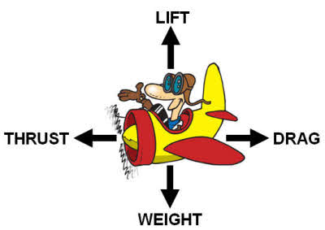
How do
Airplanes Fly?

Slide 12
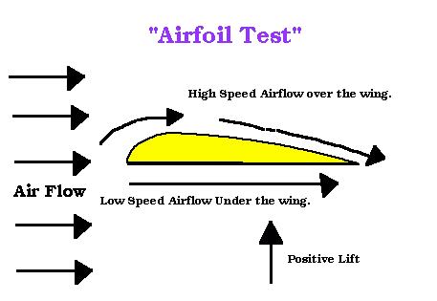
How do
Airplanes Fly?
Bernoulli’s Principle
Paper Test

Slide 13
Pilot Outlook
Looming Pilot Shortage – We NEED Pilots!
Expensive to pay for flight time
Need 1500 hours to become an airline pilot
Takes years of gaining experience
College Degree to be an airline pilot (most airlines)
Pilots get to travel for work and are away from home a couple days at a time

Slide 14
What does it take
to be a Pilot?
You have to love flying!
Be good at math and science
Learn about how weather works
Be able to read a map to find your way
Be healthy and have good vision
Take all the required flying classes
Be responsible and make good decisions
Be able to work on a team (crewmembers)
Start developing your skills now

Slide 15
Benefits
You get the best seat in the airplane with the best view!
Get paid to you what you LOVE!
Travel the world and explore new places!
Travel passes to family and friends!
Any other reasons you love being a pilot?

Slide 16
Video
Video/Commercial from the Airline you work at or about the Airplane you fly.
YouTube is a good resource.
Here are some options of Videos to show:
Boldmethod.com > A day in the life of an airline pilot
Different types of Flying: YouTube: What is General Aviation
St. Maarten Beach video on YouTube
YouTube- Landing at minimums in Aspen
Living the dream flying the B-737

Slide 17
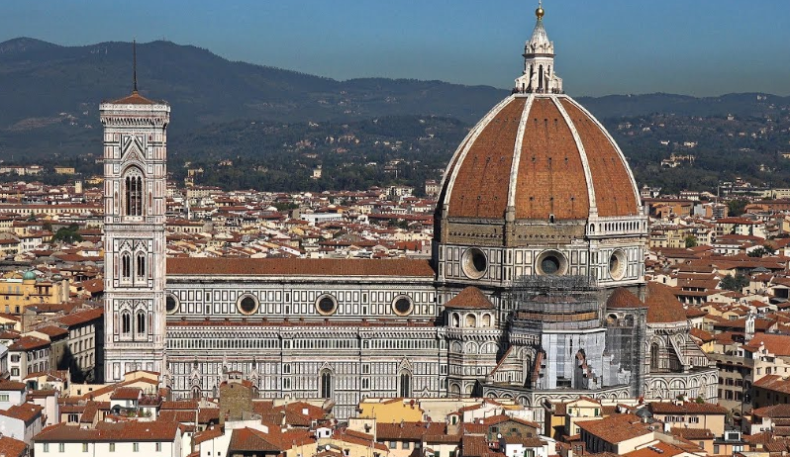
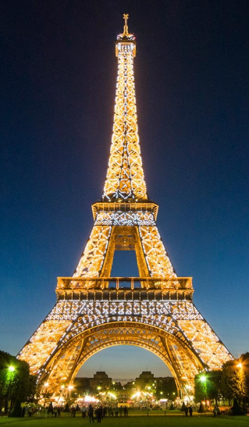
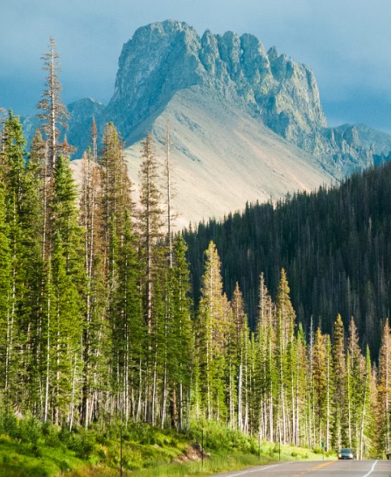
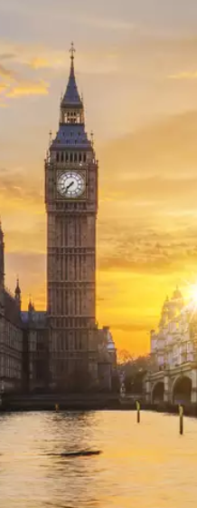
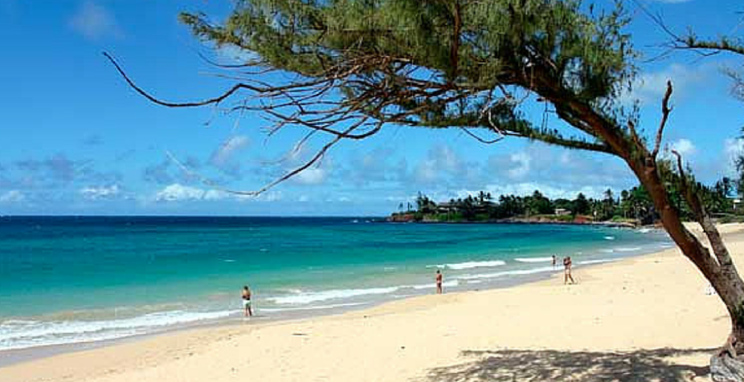
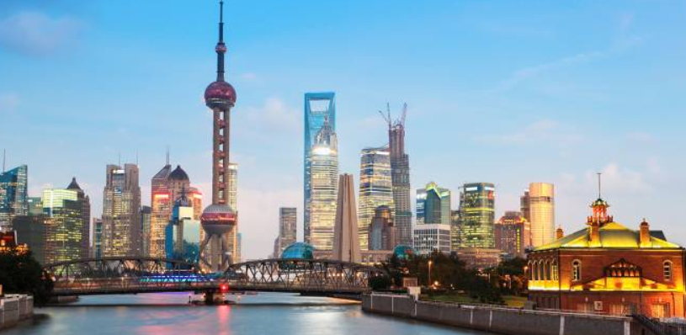
Questions?

